Slide 1
Arduino
By Kiran Hart

Slide 2
Getting started
Learn how to setup the Arduino IDE

Slide 3
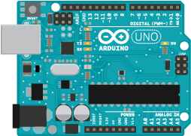
Step 1: plug in your Arduino
When you plug your Arduino board into the computer, verify that the Arduino lights up. The led next to the `UNO` writing should turn on.
You should be connecting your Arduino using this port.
This light should be on once you plug it in.

Slide 4
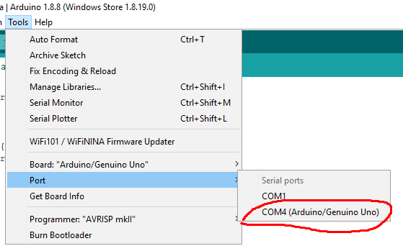
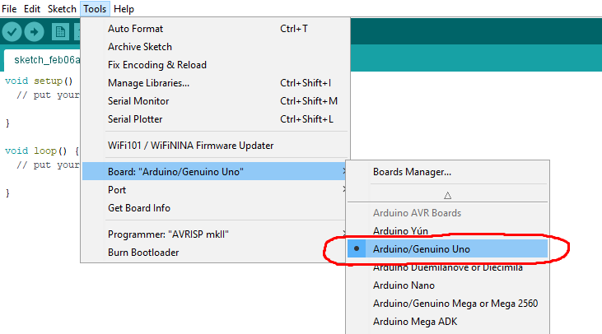
Step 2: open the Arduino ide
Once you plug it in, open the Arduino IDE, before we can program it, we need to make sure that it’s reading the Arduino correctly.
Click tools, go to board and select Arduino/Genuino Uno
After that go to `Port` under tools and select the COM which contains the (Arduino/Genuino Uno) text as seen in the top picture.
That’s all for setting it up, we can now get into the programming.

Slide 5
Programming
In this section you’ll learn how to program the Arduino board.

Slide 6
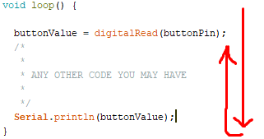
Setup() and loop()
What are they? Well their names pretty much explain them. Within the setup method you put all the code you want to run ONCE, this is usually setting up all the Pin Modes, initializing the serial monitor, pretty much anything that only needs to be ran once.
All the code you write within the loop() {} function will be ran over and over until it’s told to stop or the program closes.
All the code is ran from top to bottom, even within the setup method, so it’s important that you initialize things in order to prevent any errors. Once the program reaches the end of the loop, it will simply go straight to the top and repeat the entire process again.

Slide 7
Data types
A data type just means the way you wish to store a value within a variable, there a bunch, but here are some of the most commons you will always be using.
bool – This means that the variable can either hold a true or false value or 1 / 0
int – This will hold a whole number like 3 or 5000
String – You can create sentences with spaces or any character, the value must be within “ “.
float - Unlike an int of which holds a whole number, floats can store a number that has a decimal point like 25.7

Slide 8
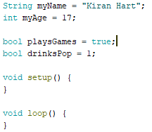
variables
Variables are things that store values that you set. To create a variable:
Specify which datatype you wish to use (see previous slide for common datatypes)
Give it a name, this can be anything you want, when creating a multi-word variable use lowerCamelCase.
Give it a value by adding an equal sign writing a value after it.
End the statement using a semi colon.
Remember Strings must be within quotes, and you can use either 1 or 0 for a bool instead of true/false.

Slide 9
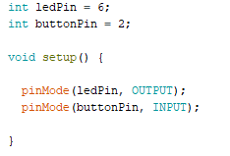
Pin modes
In every Arduino program you will need to specify what each pin should do, should it be an input or should it be an output? This will only be done once within the setup() method. Here’s an example:
The pinMode() function takes in two values, the first being a whole number (# of the pin) and the second being either OUTPUT or INPUT.
In this example I’m using my variables which are int’s that store the pin numbers, then I pass them into the pinMode function within the setup and specify whether the Arduino needs to OUTPUT to the pin or it needs to read an INPUT.

Slide 10
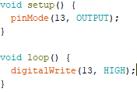
Digital write
The digtalWrite() function is a simple one, all it does is either send a LOW or HIGH value to the specified pin, when sending a HIGH value it’s sending 5 volts to the pin.
Let’s try to use it, in the setup() set pin 13 to an OUPUT using the pinMode function. (Pin 13 is the on board LED)
Inside the loop() function use the digitalWrite() function, the first value should be whichever pin you want to write to, in our case it’s 13. Since we want to turn the onboard LED on we will send a HIGH value to it
Once you do that, upload the code to the Arduino. If you did everything right, the onboard LED should turn on.

Slide 11
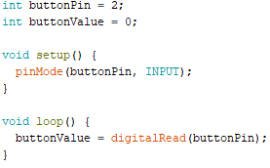
Digital read
Unlike the digitalWrite() function the digitalRead() is meant to read a value from a specific pin. It also only requires one value passed into the ().
In this example, we’re setting pin #2 to an INPUT and then constantly updating the value of `buttonValue` by using digitalRead(buttonPin) which is reading the value of pin #2.

Slide 12
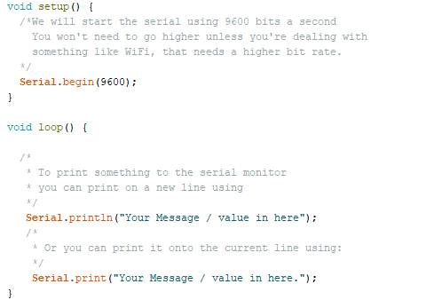
Serial Monitor
The Serial Monitor is a very useful tool as it allows us to send messages to a console helping us debug our program. It’s quite simple to use, here’s how you set it up.

Slide 13
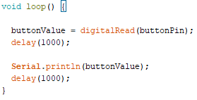
Delay
The delay function is probably the most simplest one out of all of them, all it does is pause the program for x amount of time. Here’s how to use it.
Just write delay(); and put a number in the parameters, the number represents milliseconds, so in the picture I said 1000 milliseconds or 1 second. So it’s reading the button value, pausing for 1 second, printing the value to the serial monitor then pauses for another second before repeating the loop.

Slide 14
Arithmetic operators
There’s no escaping math, in programming you will always be using math even if it’s just some simple addition. Each programming language has math operators that you can use. NOTE: Don’t forget about your order of operations.
% - Using this will get the remainder. Ex. (x = 7 % 5) x will be 2 since 5 can only go into 7 once, leaving 2 remainder.
* - Can multiply numbers. Ex (x = 5 * 5) x will be 25, since 5 times 5 is 25.
+ and - You can add / subtract numbers. Ex (x = (5 + 5) – 2 ) x will be 8 since 5 + 5 is 10 – 2 which equals 8.
/ - You can divide using this. Ex. (x = 10 / 5) x will be 2 since 10 divided by 5 is 2.

Slide 15
Comparison operators
These just let you check if things are equal to each other or if numbers or not equal, greater than, less than another.
!= → This means not equal to Ex. If (5 != 4) {do something}
< → This means less than Ex. If (5 < 6) {do something}
> → This means greater than Ex. If (10 > 9) {do something}
<= → This is less than or equal to Ex. If (4 <= 5) {do something}
>= → This means greater than or equal to Ex. If (5 >= 5) {do something}
== → This means both values are equal Ex. If (100 == 100) {do something}

Slide 16
and, or, not
What are these? Well they’re Booleans operators. They’re very simple to use. But what do they mean?
&& (and) → This means that (statement one) && (statement two) must be true
|| (or) → This means that (statement one) || (statement two) must be true
! (not) → This means ! (statement) is not, it reverses true/false. So !true will be false and !false will be true, so if the statement is true, it’s now false, vice versa.

Slide 17
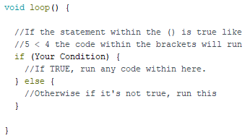
If / else statements
IF / ELSE statements are used to check if something is “true” if so run some specific instructions “ELSE” if it’s not true, run another set of instructions. Here’s an Example:
int age = 19
if (age >= 18) {
Run the code
} else if (age >= 13 && age <= 17) {
Run the code
} else {
Run the code
}

Slide 18
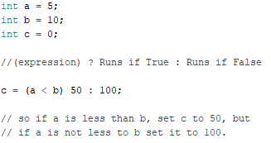
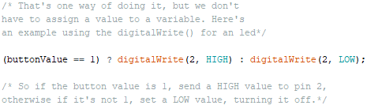
Conditional Operators (?)
Conditional operators are quite cool. They allow you do something if the given expression is true, otherwise do another. They’re like if / else statements but shorter. These are usually used when assigning variable data. Here’s how to use them.

Slide 19
Projects
Now that you know the basics of programming, let’s make some projects

Slide 20
Project list #1
1. Blink an LED ON/OFF
2. Fade an LED ON/OFF
3. Read a push button input
4. Turn an LED on using a push button
5. Read the temperature using an LM35
6. Ultra Sonic Sensor distance check

Slide 21
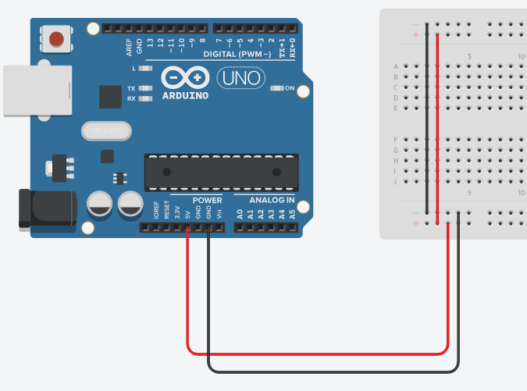
Before we start
Before we can start, we need to connect our Arduino to our breadboard, now this is quite easy as the Arduino has 3 Ground connections, a 5V and 3.3V, follow this image.
Now I’m using the GND next to the 5V but you can use whichever one you want.

Slide 22
Project #1
Blink an LED ON and OFF
Items Needed:
An Arduino
A Breadboard
An LED
Jumper Wires

Slide 23
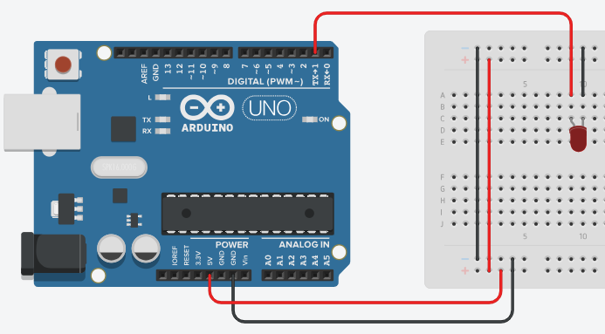
Project #1 - Wiring
Connect your GND/5V from the Arduino to the breadboard.
Connect the LED cathode to ground
Connect the LED anode to a digital pin, I chose 1 in this example.

Slide 24
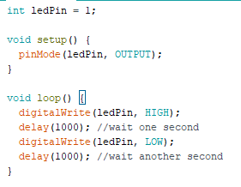
Project #1 - programming
First I create an int called `ledPin` and assign it a value of 1 since we connected our LED to digital pin #1
Within the setup method I set the pin mode of digital pin #1 to OUTPUT.
Within the loop method I use digitalWrite to set the `ledPin` to HIGH (turn the led on)
I delay the process by 1 second
Using the digitalWrite once more I set `ledPin` or digital pin #1 to LOW (turn the led off)
I delay it by a second once more before letting the loop restart.

Slide 25
Project #2
Fade an LED ON and OFF
Items Needed:
An Arduino
A Breadboard
An LED
A 220 Ohm resistor
Jumper Wires

Slide 26
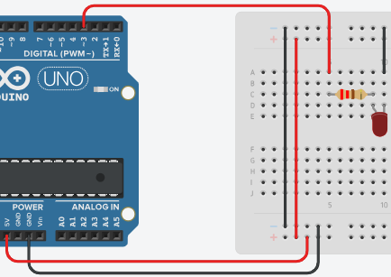
Project #2 - Wiring
Connect your GND/5V from the Arduino to the breadboard.
Connect the LED cathode to ground
Connect the 220 Ohm resistor to the anode end of the LED
Connect the other end of the resistor to a digital pin, in my case I chose digital pin #3
I chose 3 because we will be using analogWrite() instead of digitalWrite(). AnalogWrite works best on pins 3, 5, 6, 9, 10 and 11.

Slide 27
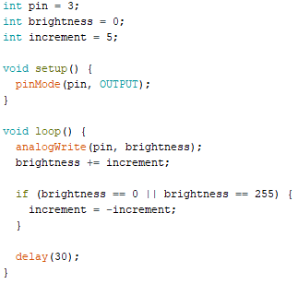
Project #2 - programming
First I create 3 int variables, one two store the pin the LED in connected to, a brightness counter, and the increment.
I then set the pinMode to OUTPUT on ledPin (digital pin #3)
Within the loop I use analogWrite() instead of digitalWrite since it allows to change the brightness of an LED.
I then increment the brightness by the increment. (+= is a shorter way to adding to a #
Then I check if the brightness is equal to || (or) 255 then revert the increment, by setting it to negative of itself.
I then delay the loop by 30 milliseconds, this number can be changed around, but 30 seems to be the best to see the fading affect.

Slide 28
Project #3
Read a push button input
Items Needed:
An Arduino
A Breadboard
A 10k resistor
Jumper Wires
A push button

Slide 29
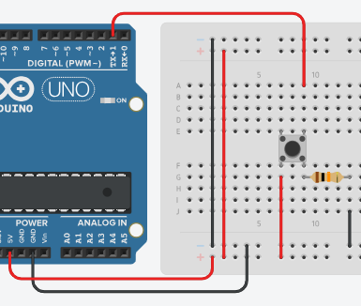
Project #3 - Wiring
Connect your GND/5V from the Arduino to the breadboard.
Connect the button left pin of the push button to +5v
Using a 10k resistor connect the bottom right pin of the push button to ground.
Now connect the top right pin of the push button to a digital pin, I chose digital pin #1 for this example.

Slide 30
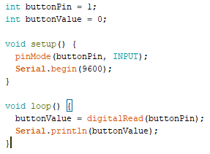
Project #3 - programming
I first created two int variables, one to store which pin the button is connected to, and one to store the value of the button.
In the setup I set the pinMode of the `buttonPin` to an INPUT since we’re going to be reading data from the button. I also start the Serial Monitor (see slide 12) so we can output the buttonValue.
Within the loop I set the buttonValue variable to the value of the button by using the digitalRead method, this will read a value on a specific pin (pin 1 in our case)
Finally I print the value of `buttonValue` to the serial monitor, when the button isn’t being pressed it should print 0, when it’s being pressed it should print 1.

Slide 31
Project #4
Read a push button input
Items Needed:
An Arduino
A Breadboard
A 10k resistor
Jumper Wires
A push button
An LED

Slide 32
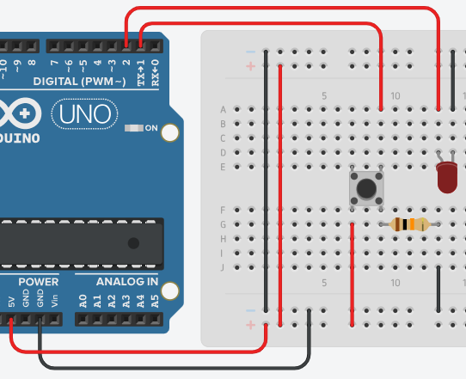
Project #4 - Wiring
Connect your GND/5V from the Arduino to the breadboard.
Connect the bottom left pin of the push button to +5v
Using a 10k resistor connect the bottom right pin of the push button to ground.
Now connect the top right pin of the push button to a digital pin, I chose digital pin #1 for this example.
Connect the LED Cathode to ground.
Connect the LED Anode to a digital pin, I chose digital pin #2

Slide 33
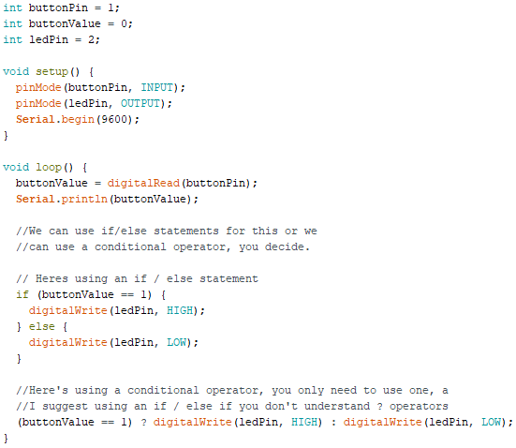
Project #4 - programming
Building off the last project, I create a new int variable named `ledPin` and assign it to 2.
I then setup the pinMode for the `ledPin` to OUTPUT, since we’re going to be sending data to that pin #.
Within the loop, I use and if / else statement to check if the button is being pressed (if buttonValue is 1) if so, digitalWrite a HIGH value to the pin the led is connected to, otherwise, send a LOW value causing it to turn off.
At the very bottom I show you how to use a conditional operator to either send a HIGH / LOW value to a digital pin. So if (buttonValue equals 1) ? Use digitalWrite to send a HIGH value to the led : otherwise if it’s not one (button not being pressed) turn the led off by sending a LOW value.

Slide 34
Project #5
Read the temperature using an LM35 Chip
Items Needed:
An Arduino
A Breadboard
Jumper Wires
An LM35 Chip

Slide 35
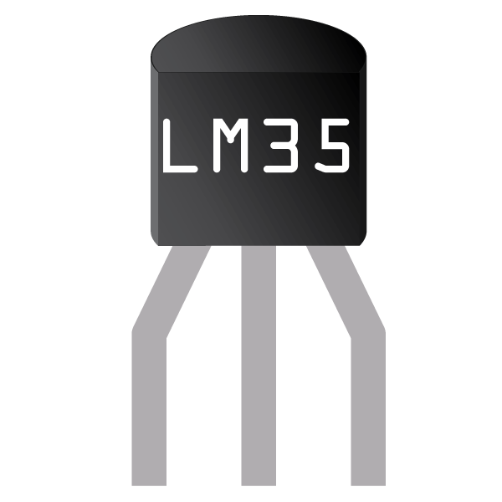
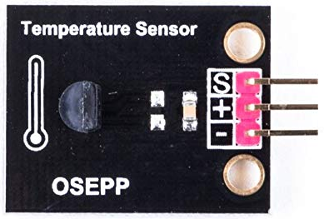
Lm35 temperature chip
Before we get into the wiring, we’ve got to know which pins are which on the LM35. Unless stated otherwise, the standalone chip will have the same vcc/gnd/vout pins. In some cases if the sensor is attached to a board, the manufacture will state on the board which pin does. Note the flat side of the sensor is the front, so keep that in mind when wiring it. The standalone is on the left, board on the right.
As you can see in this case, the data pin / signal is all the way on the right compared to being in the middle on the standalone sensor.
+5v
Data pin
Ground

Slide 36
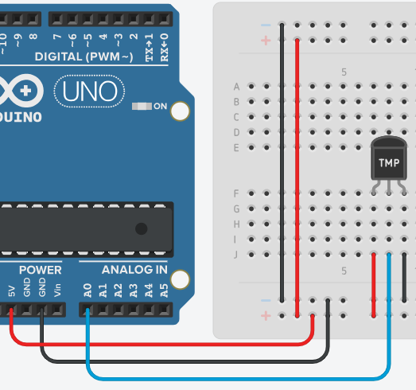
Project #5 - Wiring
Connect your GND/5V from the Arduino to the breadboard.
Connect the GND pin on the LM35 to ground on the breadboard.
Connect the power pin on the LM35 to +5v
Connect the data pin (middle one) on the LM35 to an analog in pin, I chose analog pin 0 (A0)

Slide 37
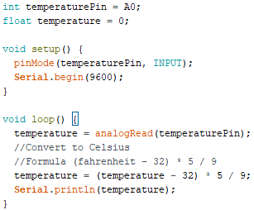
Project #5 - programming
First I create an int variable storing the analogPin (A0) since that’s where the sensor is connected to. Then I create a float (since we’re going to be using decimal numbers) and set it to zero by default.
In the setup I set the temperature pin (A0) to an INPUT since we’re going to be reading data. I also start the serial monitor on 9600.
In the loop I update the `temperature` variable by using analogRead, I passed in the pin that it should read from `temperaturePin` or A0.
Now we update the `temperature` using the formula to convert Fahrenheit to Celsius. So we set it to itself minus 32 then we multiply it by 5 divided by 9
Finally we print the temperature to the serial monitor.

Slide 38
Project #6
Ultrasonic sensor distance check.
Items Needed:
An Arduino
A Breadboard
Jumper Wires
An HC-SR04 Ultrasonic sensor

Slide 39
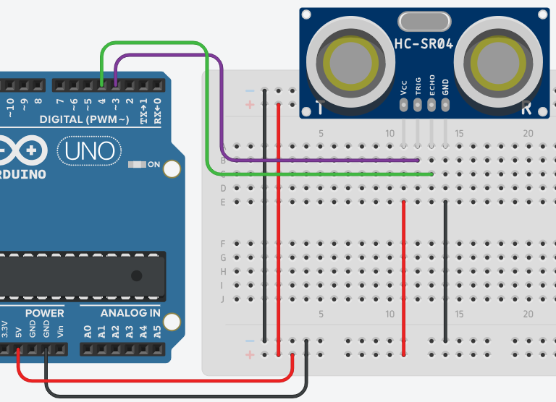
Project #6 - Wiring
Connect your GND/5V from the Arduino to the breadboard.
Connect the GND pin on the sensor to ground on the breadboard.
Connect the power pin on the sensor to +5v
Connect the Trig and Echo pin to a digital pin, I chose pin 4 for the echo pin and pin 3 for the Trig pin.

Slide 40
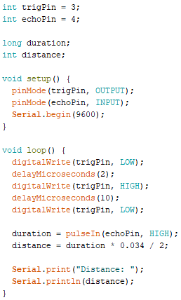
Project #5 - programming
First create two int variables that store the pin which you connected the trig and echo pin to.
Create a long variable for the duration of the sensor, it doesn’t need any values right now, also create another int variable to store the distance.
Within the setup, set the trigPin variable to OUTPUT and the echoPin to INPUT and start the serial monitor on a 9600 bit data rate.
Within the loop we’re going to use a new delay method called `delayMicroseconds` it’s same the as delay() but works in microseconds. So send a low value to the trig pin, delay for 2 microseconds, send a high value to the trig pin, delay for another 10 microseconds then send low value back to the trig pin.
Now assign a value to the duration variable using pulseIn(), passing in the echoPin variable as the first parameter and giving it a HIGH value for the 2nd parameter.
Now set the distance equal to the duration multiplied by 0.034 divided by 2 (this is the calculation to convert it into centimeters)
Finally, just print the distance to the serial monitor.

Slide 41
Project list #2
7. Binary Counter (1 - 7 Segment)
8. IR Sensor (Black/White detection)

Slide 42
Project #7
Binary Counter (One 7 Segment display)
Items Needed:
An Arduino
A Breadboard
Jumper Wires
A common anode 7 segment display

Slide 43
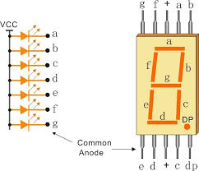
7 segment display (common anode)
We will be using the Common Anode 7 segment display, before we can start the project you should know how it’s wired. More specifically which pins represent each letters / segments. There are 7 segments, each as their own pin that can be used to either turn it on and off.

Slide 44
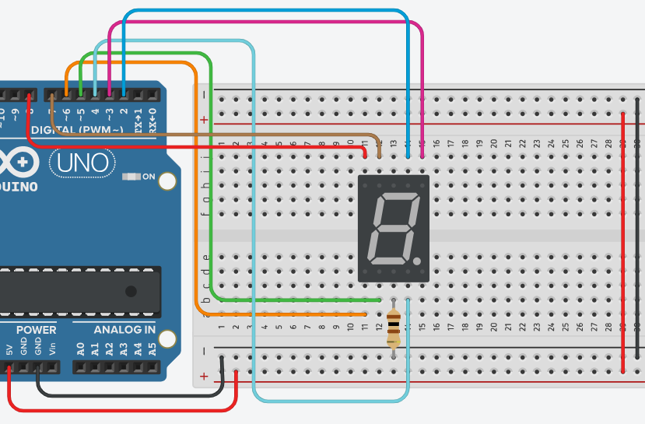
Project #7 - Wiring
Connect your GND/5V from the Arduino to the breadboard.
Connect a 100 Ohm resistor from pin 3 of the 7 segment display to ground.
E to digital pin #6
D to digital pin #5
C to digital pin #4
B to digital pin #3
A to digital pin #2
F to digital pin #7
G to digital pin #8

Slide 45
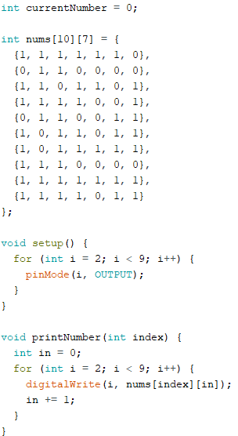
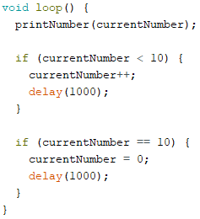
Project #7 - programming
First we create a variable to store the current number it should display.
Then we make a multi-dimensional array to store the number values. 1 meaning high , 0 meaning low. For example nums[0] will give us the array containing the values to print zero.
We then setup our pins from 2 to 8 as an OUTPUT
Then we make a method called printNumber that will take in a int parameter, this will loop through the specified index of nums and digitalWrite either high or low based on each of the 7 values that it finds in the array index.
Within the loop we simply call the printNumber function, passing in the current number it should print. Then we just increment the number if it’s less than ten, if it’s 10, reset it to zero.
* See the next slide for an easier version of the code, and links to showing off multi-dimensional arrays *

Slide 46
Project 7 - help
Code shown in PowerPoint:
https://github.com/kiranhart/Arduino-Powerpoint/blob/master/Code/Project_7v2.ino
Long code/Easy Code:
https://github.com/kiranhart/Arduino-Powerpoint/blob/master/Code/Project_7_v1.ino
Multi-dimensional Arrays:
https://www.tutorialspoint.com/arduino/arduino_multi_dimensional_arrays.htm
Function/Methods:
https://www.arduino.cc/en/Reference/FunctionDeclaration

Slide 47
Project #8
IR Sensor
Items Needed:
An Arduino
A Breadboard
Jumper Wires
QTI Sensor

Slide 48
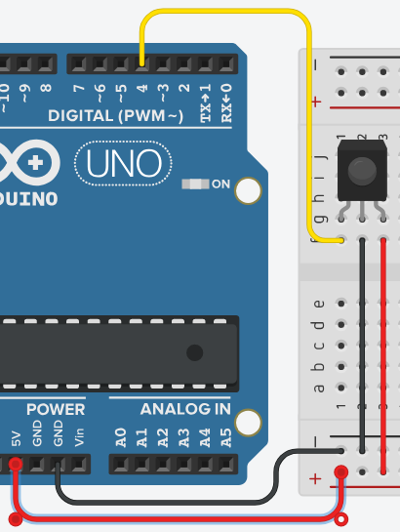
Project #8 - Wiring
Connect your GND/5V from the Arduino to the breadboard.
Connect pin B from the sensor to negative
Connect pin W from the sensor to positive
Connect pin R from the sensor to a digital pin on the Arduino.
Pin R will be sending the data, so make sure you know which digital pin you connect it to, for future use in the code.

Slide 49
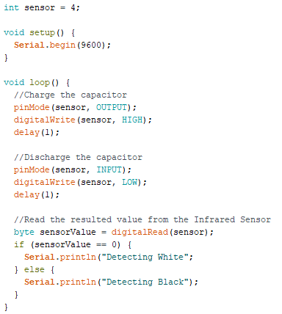
Project #8 - programming
First we create a int variable to store the pin our sensor is connected to called `sensor` and assign it a value of 4
We then setup the serial monitor on a 9600 bit data rate.
In the loop, we need to charge the capacitor, so we set the pinMode to OUTPUT on the sensor pin, then digitalWrite a HIGH value to the sensor, then delay for 1 millisecond.
Now we discharge the capacitor, but instead of OUTPUT and HIGH we will use INPUT and LOW to release it. Delay for another 1 millisecond.
Now lets create a variable called `sensorValue` and assign it to digitalRead(sensor) which reads the value of the sensor. We used a byte since the number should only be a zero or one.
Now we check if the sensorValue is equal to zero, if it is zero, then it means the sensor is detecting a white surface, otherwise if it’s not zero, then it should be one, meaning that it’s detecting a black surface.

Slide 50
The End
Congratulations you’ve reached the end.
All the code & Images used throughout this presentation can be found at:
https://github.com/kiranhart/Arduino-Powerpoint

